Slide 1
Structures (CS 217)
Mr. Jawad Hassan,
17-10-2020
Department of Computer Science,
National University of Computer & Emerging Sciences, Islamabad Campus

Slide 2
Structure
A Structure is a container, it can hold a bunch of things.
These things can be of any type.
Structures are used to organize related data (variables) into a nice neat package.

Slide 3
Introducing Structures
A structure is a collection and is referenced with single name.
The data items in structure are called structure members, elements, or fields.
The difference between array and structure: is that array must consists of a set of values of same data type but on the other hand, structure may consists of different data types.

Slide 4
Defining the Structure
Structure definition tells how the structure is organized: it specifies what members the structure will contain.
Syntax & Example →
Syntax:
struct StructName
{
DataType1 Identifier1;
DataType2 Identifier2;
.
.
.
};
Example:
struct Product
{
int ID;
string name;
float price;
};

Slide 5
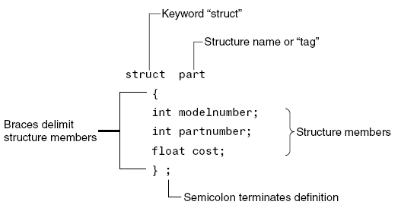
Structure Definition Syntax

Slide 6
Structure members in memory
Memory is only allocated when we create struct type variables
modelnumber
4 Bytes
struct part
{
int modelnumber;
int partnumber;
float cost;
};
partnumber
4 Bytes
cost
4 Bytes
Notes:
Memory Allocation for Structure. If we create an object of some structure, then compiler allocate contiguous memory for the data members of the structure. The size of allocated memory is at least the sum of sizes of all data members.

Slide 7
Declaring a Structure variable
Structure variable can be created after the definition of a structure. The syntax of the declaration is:
StructName Identifier;
Example:
part processor;
part keyboard;

Slide 8
Another way of Declaring a Structure variable
You can also declare struct variables during definition of the struct. For example:
struct part
{
int modelnumber;
int partnumber;
float cost;
} part1;
These statements define the struct named part and also declare part1 to be a variable of type part.

Slide 9
Examples
struct Employee
{
string firstName;
string lastName;
string address;
double salary;
int deptID;
};
Employee e1;
struct Student
{
string firstName;
string lastName;
char courseGrade;
int Score;
double CGPA;
} s1, s2;

Slide 10
Initializing Structure Variables
The syntax of initializing structure is:
StructName struct_identifier = {Value1, Value2, …};

Slide 11
Structure Variable Initialization with Declaration
struct Student
{
string firstName;
string lastName;
char courseGrade;
int marks;
};
void main( )
{
Student s1= {“M”, “Umar”, ‘A’, 94} ;
}
Note: Values should be written in the same sequence in which they are specified in structure definition.

Slide 12
Assigning Values to Structure Variables
After creating structure variable, values to structure members can be assigned using dot (.) operator
The syntax is as follows:
student s1;
s1.firstName = “Muhammad”;
s1.lastName = “Umar”;
s1.courseGrade = ‘A’;
s1.marks = 93;

Slide 13
Assigning Values to Structure Variables
After creating structure variable, values to structure members can be assigned using cin
Output to screen using cout
student s1;
cin>>s1.firstName;
cin>>s1.lastName;
cin>>s1.courseGrade;
cin>>s1.marks ;
cout<<s1.firstName<<s1.lastName;

Slide 14
Assigning one Structure Variable to another
A structure variable can be assigned to another structure variable only if both are of same type
A structure variable can be initialized by assigning another structure variable to it by using the assignment operator as follows:
Example:
studentType newStudent = {“Amir”, “Ali”, ‘A’, 98} ;
studentType student2 = newStudent;

Slide 15
Array of Structures
An array of structure is a type of array in which each element contains a complete structure.
struct Book
{
int ID;
int Pages;
float Price;
};
Book Library[100]; // declaration of array of structures
…
Library[0]
Library[1]
Library[99]
ID
Pages
Price
ID
Pages
Price
ID
Pages
Price

Slide 16
Initialization of Array of Structures
struct Book
{
int ID;
int Pages;
float Price;
};
Book b[3]; // declaration of array of structures
Initializing can be at the time of declaration
Book b[3] = {{1,275,70},{2,600,90},{3,786,100}};
Or can be assigned values using cin:
cin>>b[0].ID ;
cin>>b[0].Pages;
cin>>b[0].Price;

Slide 17
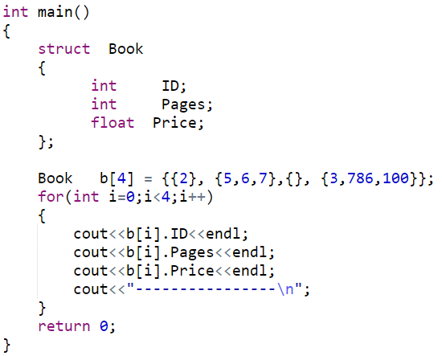
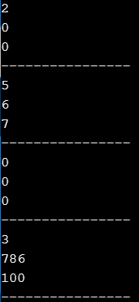
Partial Initialization of Array of Structures
Notes:
book b[5]={{2},{50,30,20.5}, {,,400}, {},{4,600, 350.8}}; // Error because of the invalid partial initialization

Slide 18
Array as Member of Structures
A structure may also contain arrays as members.
struct Student
{
int RollNo;
float Marks[3];
};
Initialization can be done at time of declaration: Student S = {1, {70.0, 90.0, 97.0} };

Slide 19
Array as Member of Structures
Or it can be assigned values later in the program:
Student S;
S.RollNo = 1;
S.Marks[0] = 70.0;
S.Marks[1] = 90.0;
S.Marks[2] = 97.0;
Or user can use cin to get input directly:
cin>>S.RollNo;
cin>>S.Marks[0];
cin>>S.Marks[1];
cin>>S.Marks[2];

Slide 20
Nested Structure
A structure can be a member of another structure: called nesting of structure.
struct A
{
int x;
double y;
};
struct B
{
char ch;
A v1;
};
B record;
record
v1
ch
x
y

Slide 21
Initializing/Assigning to Nested Structure
struct A{
int x;
float y;
};
struct B{
char ch;
A v2;
};
void main() // Input
{
B record;
cin>>record.ch;
cin>>record.v2.x;
cin>>record.v2.y;
}
void main() // Assignment
{
B record;
record.ch = ‘S’;
record.v2.x = 100;
record.v2.y = 3.6;
}
void main() // Initialization
{
B record = {‘S’, {100, 3.6} };
}

Slide 22
Accessing Structures with Pointers
Pointer variables can be used to point to structure type variables too.
The pointer variable should be of same type, for example: structure type
struct Rectangle {
int width;
int height;
};
void main( )
{
Rectangle rect1={22,33};
Rectangle* rect1Ptr = &rect1;
}

Slide 23
Accessing Structures with Pointers
How to access the structure members (using pointer)?
Use dereferencing operator (*) with dot (.) operator
struct Rectangle {
int width;
int height;
};
void main( )
{
Rectangle rect1={22,33};
Rectangle* rectPtr = &rect1;
cout<< (*rectPrt).width<<(*rectPrt).height;
}
Notes:
It is used with a pointer variable pointing to a structure, union, or Class.

Slide 24
Accessing Structures with Pointers
Is there some easier way also?
Use arrow operator ( -> )
struct Rectangle {
int width;
int height;
};
void main( )
{
Rectangle rect1={22,33};
Rectangle* rectPtr = &rect1;
cout<< rectPrt->width<<rectPrt->height;
}

Slide 25
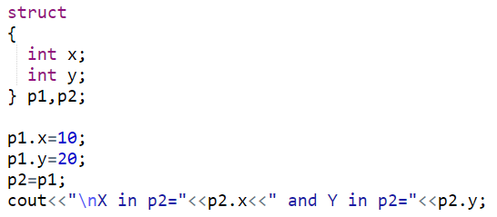
Anonymous Structure
Structures can be anonymous:

Slide 26
Other stuff you can do with a struct
You can also associate functions with a structure (called member functions)
A C++ class is very similar to a structure, we will focus on classes.
can have (data) members
can have member functions.
can also hide some of the members (functions and data).

Slide 27
Quick Example
struct StudentRecord {
char *name; // student name
int marks[5]; // test grades
double ave; // final average
void print_ave( ) {
cout << "Name: " << name << endl;
cout << "Average: " << ave << endl;
}
};

Slide 28
Using the member function
StudentRecord stu;
… // set values in the structure
stu.print_ave( );

Slide 29
Structures and Functions
Structures can be passed in a function:
Pass-by-value
Pass-by-reference
Pass-by-reference (using pointers)

Slide 30
Structures and Functions – By Value

Slide 31
Notes:
cout << setprecision(2) << fixed;
When the fixed manipulator is used, all floating point numbers that are subsequently
printed will be displayed in fixed point notation, with the number of digits to the right of
the decimal point specified by the setprecision manipulator.

Slide 32
Structures and Functions – By Value
Problem: copy of a large structure takes time and a lot of memory
Solution: Pass-by reference (conserves the memory)
Problem: Function can update/change original values…
Solution: constant reference

Slide 33
Structures and Functions
Structures can be returned by a function

Slide 34
Structures Vs. Classes
Members in Structures are default public
Members in Classes are default private
Traditionally, structures are used in 'C' language for holding records consisting of many data values
Classes are meant to describe objects having both private state/data and public member functions

Slide 35
Practice Question 1
Define a structure called “car”. The member elements of the car structure are:
string Model;
int Year;
float Price
Create an array of 30 cars. Get input for all 30 cars
from the user. Then the program should display
complete information (Model, Year, Price) of those
cars only which are above 500000 in price.

Slide 36
Practice Question 2
Write a program that implements the following using C++ struct. The program should finally displays the values stored in a phone directory (for 10 people)
PhoneDirectory
Name
PhoneNo
Address
City
Country

